Slide 1

Variability of the Meridional Overturning Circulation observed since 1993 across the A25-OVIDE section in the North Atlantic subpolar gyre, and its impact on the physical pump of the anthropogenic CO₂
P. Lherminier ; H. Mercier ; N. Daniault ; FF. Perez ; P. Zunino ; MI. García-Ibáñez ; A. Sarafanov F. Gaillard ; P. Morin ; AF. Rios ; D. Desbruyères ; A. Falina ; B. Ferron ; T. Huck ; V. Thierry
Laboratoire de Physique des Océans, UMR6523, Plouzané, France
Instituto Investigaciones Marinas (CSIC ), Departamento de oceanografia, VIGO, Spain;
P.P. Shirshov Institute of Oceanology, Moscow, Russia;

Slide 2
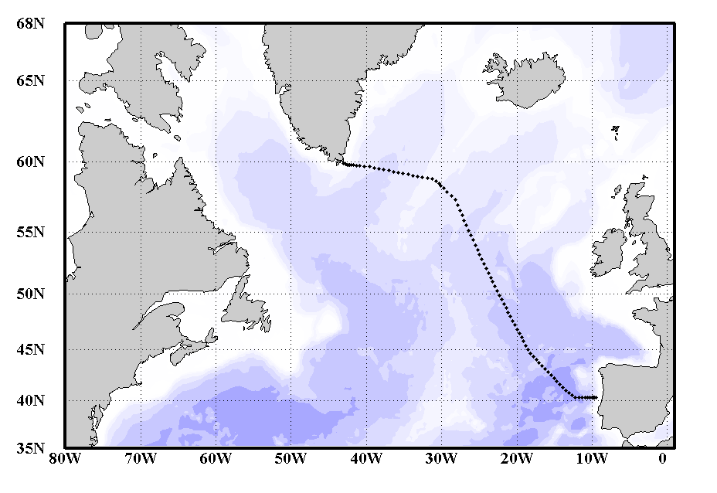
Observing the ocean
Combining satellite altimetry and ARGO data, we built an index of the Meridional Overturning Circulation in the north-east Atlantic since 1993
This index was validated by in-situ independent estimates from biennial OVIDE oceanographic cruises since 2002

Slide 3
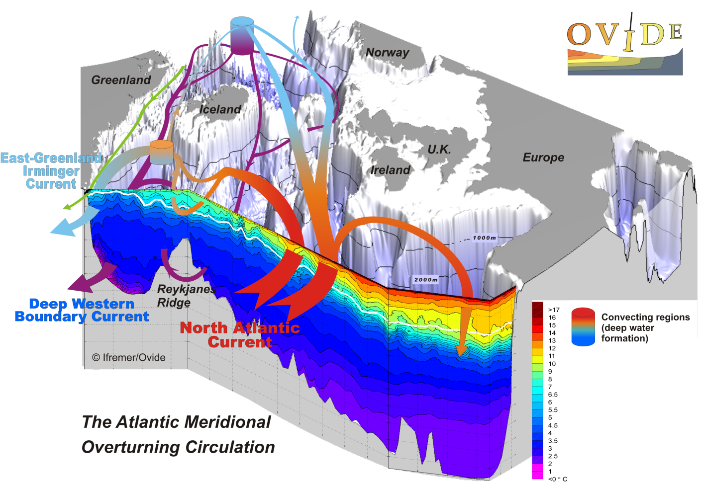
Meridional Overturning Circulation
Mercier et al., 2015

Slide 4
Variability of the MOC
A strong decadal variability is observed, confirmed by the latest observations
Models give clues on the underlying mechanisms (Visbeck et al., 2003; Barrier et al., 2014…)
The intensity of the MOC is essential not only for the heat transport to the Arctic, but also for the storage of anthropogenic CO₂ in the North Atlantic, that accounts for 25% of the total storage in the ocean.

Slide 5
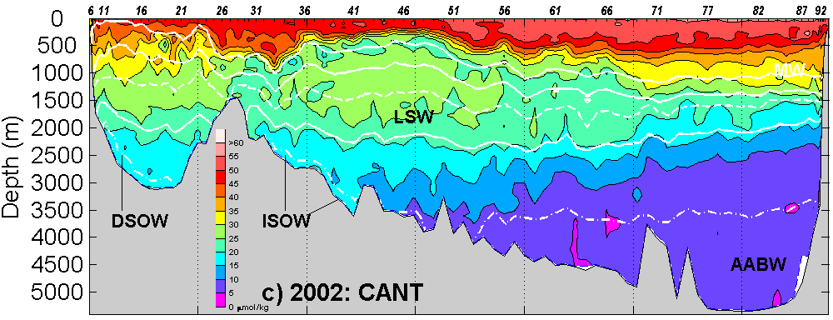
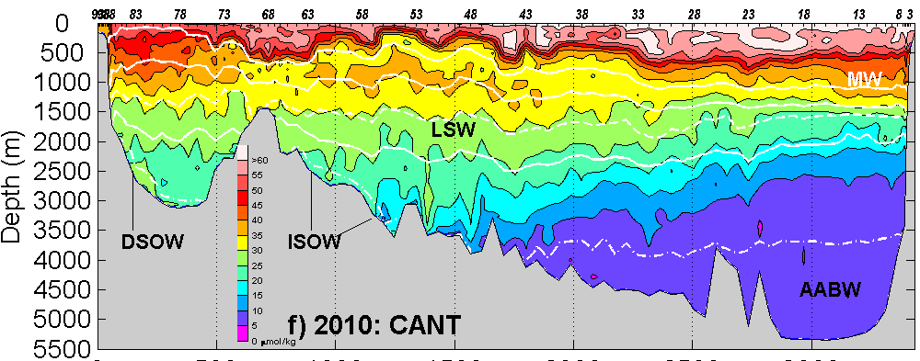
CO₂ storage in the North Atlantic
The concentration of anthropogenic carbon increases in the whole subpolar gyre
Its storage is modulated by the intensity of the MOC that brings the Cant-rich subtropical water to the areas of deep-water formation (Perez et al., 2013)
An index was built to evaluate the impact of the MOC on the CO₂ physical pump in models (Zunino et al., 2014)

Slide 6

Thank you

