Slide 1
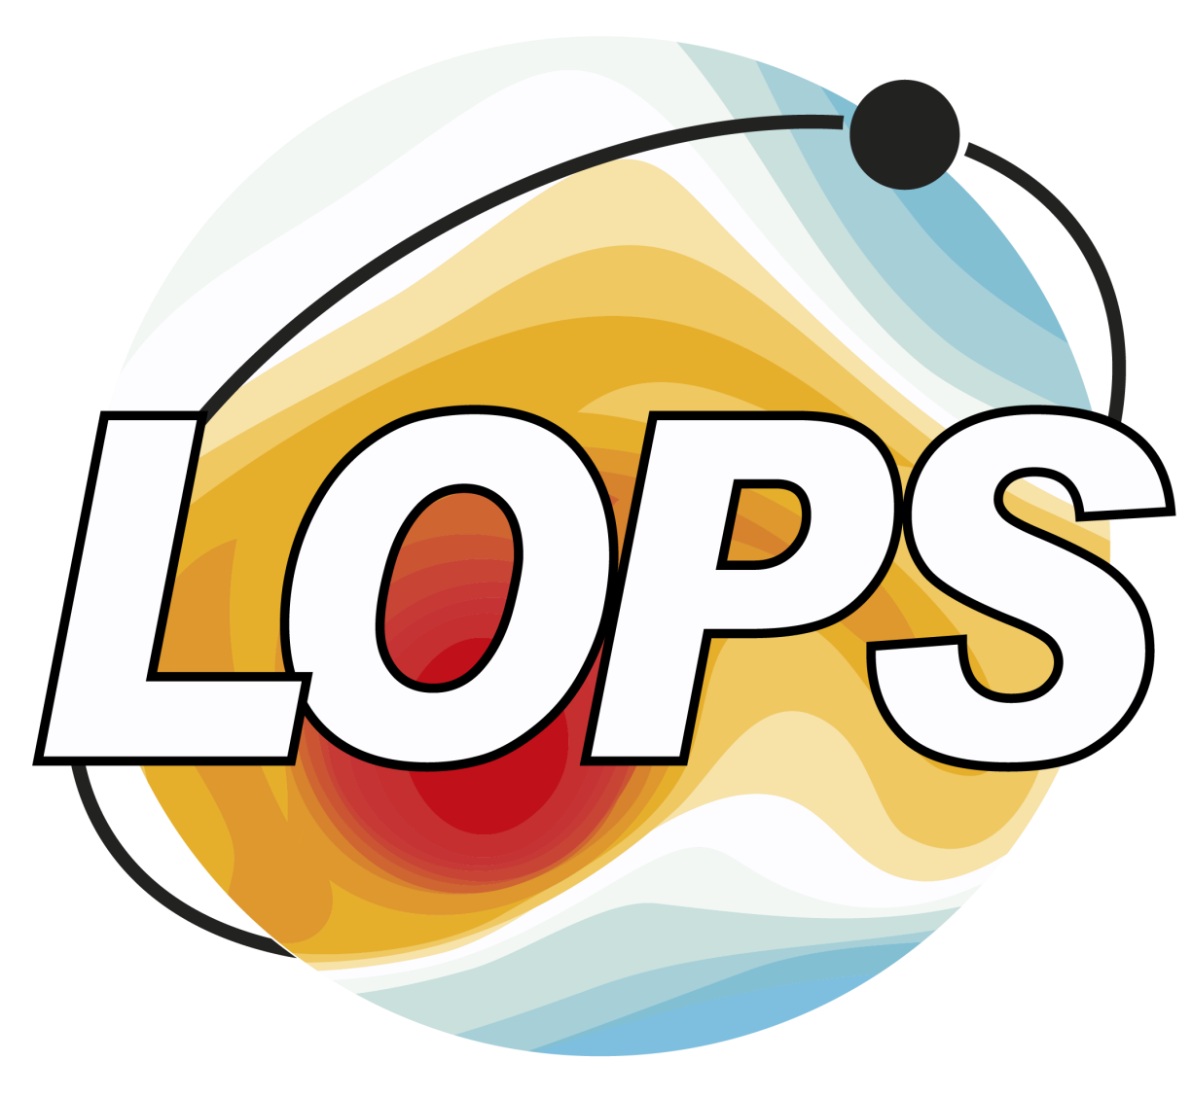
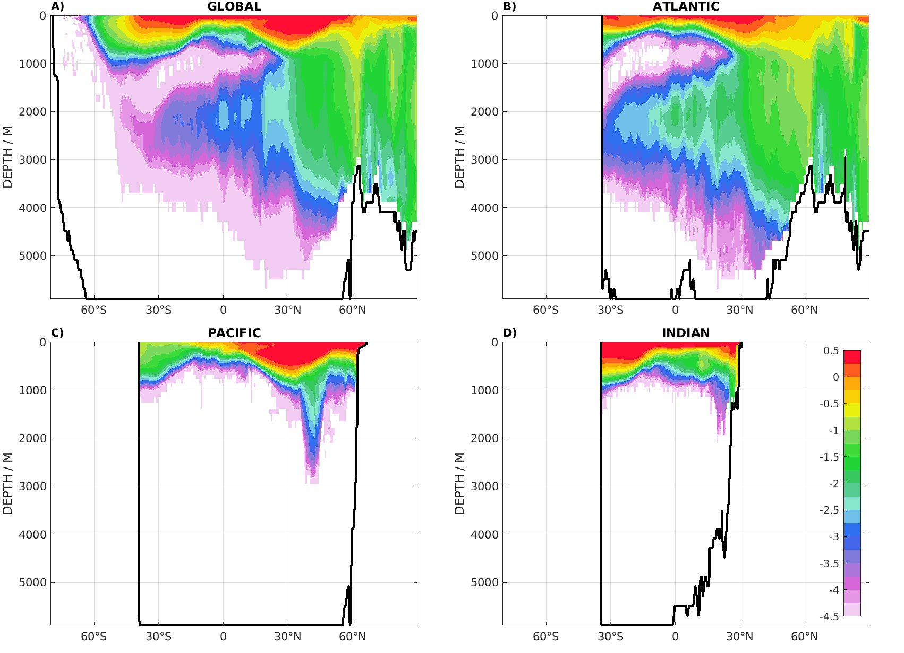
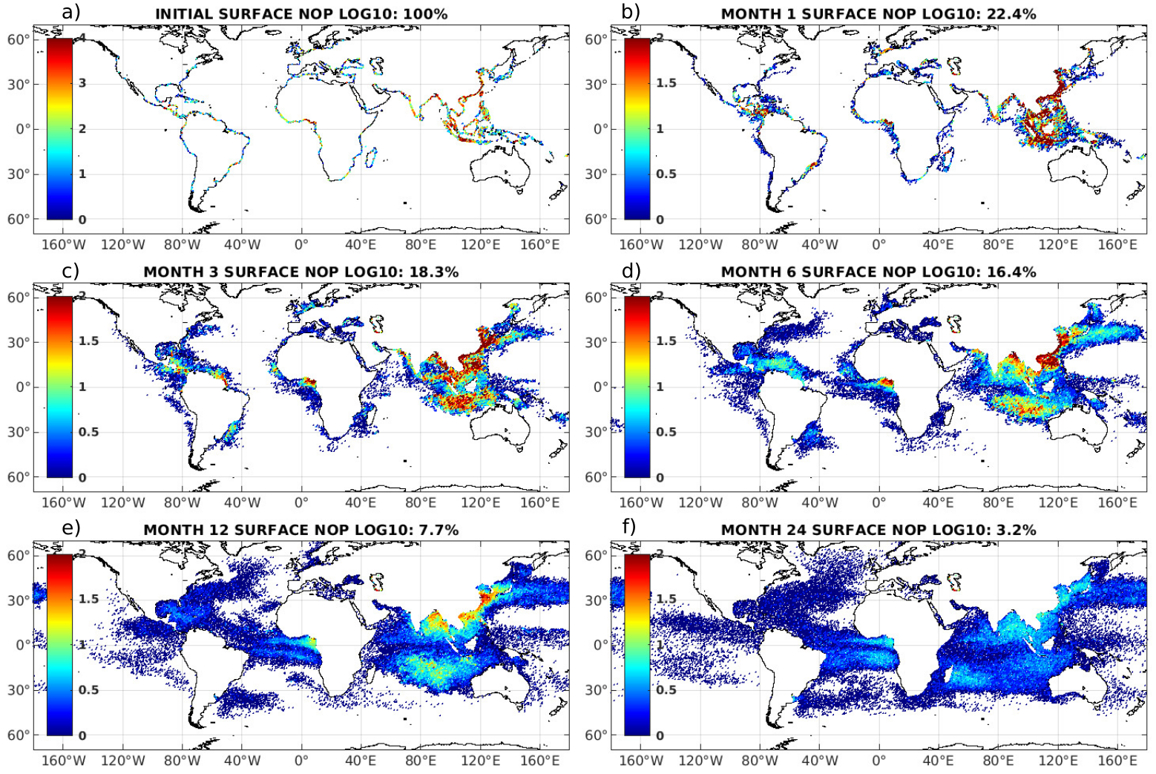
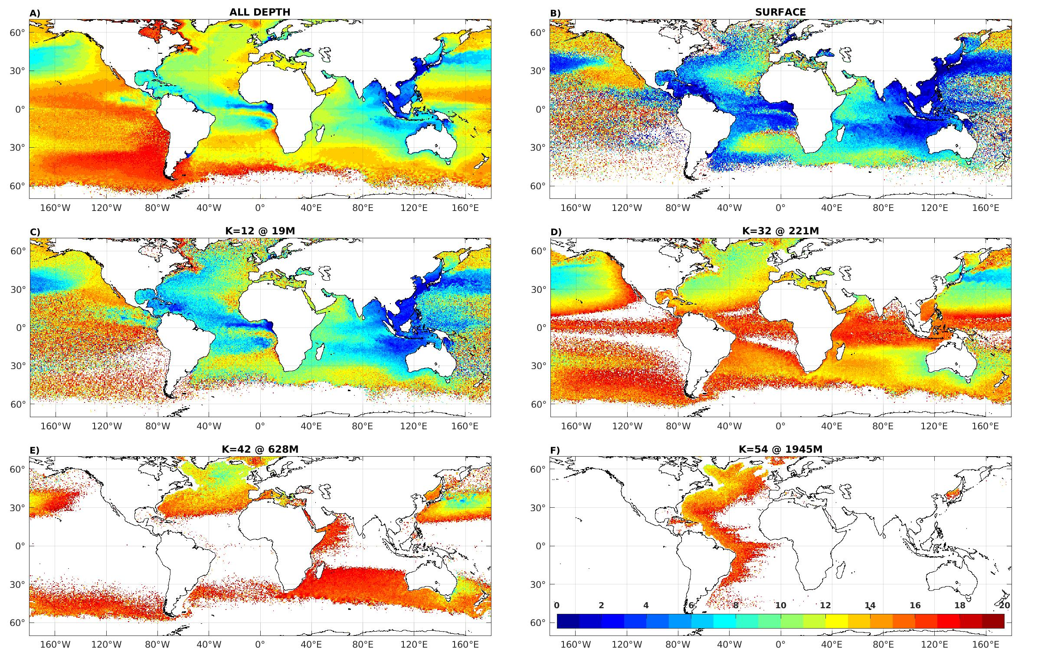
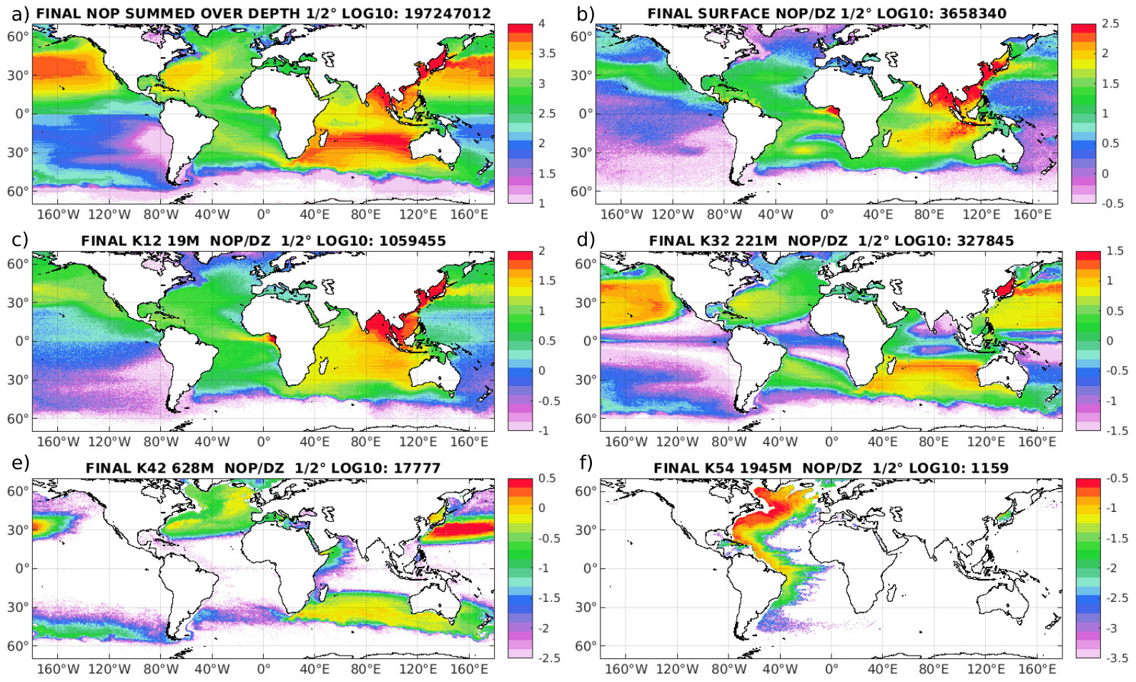
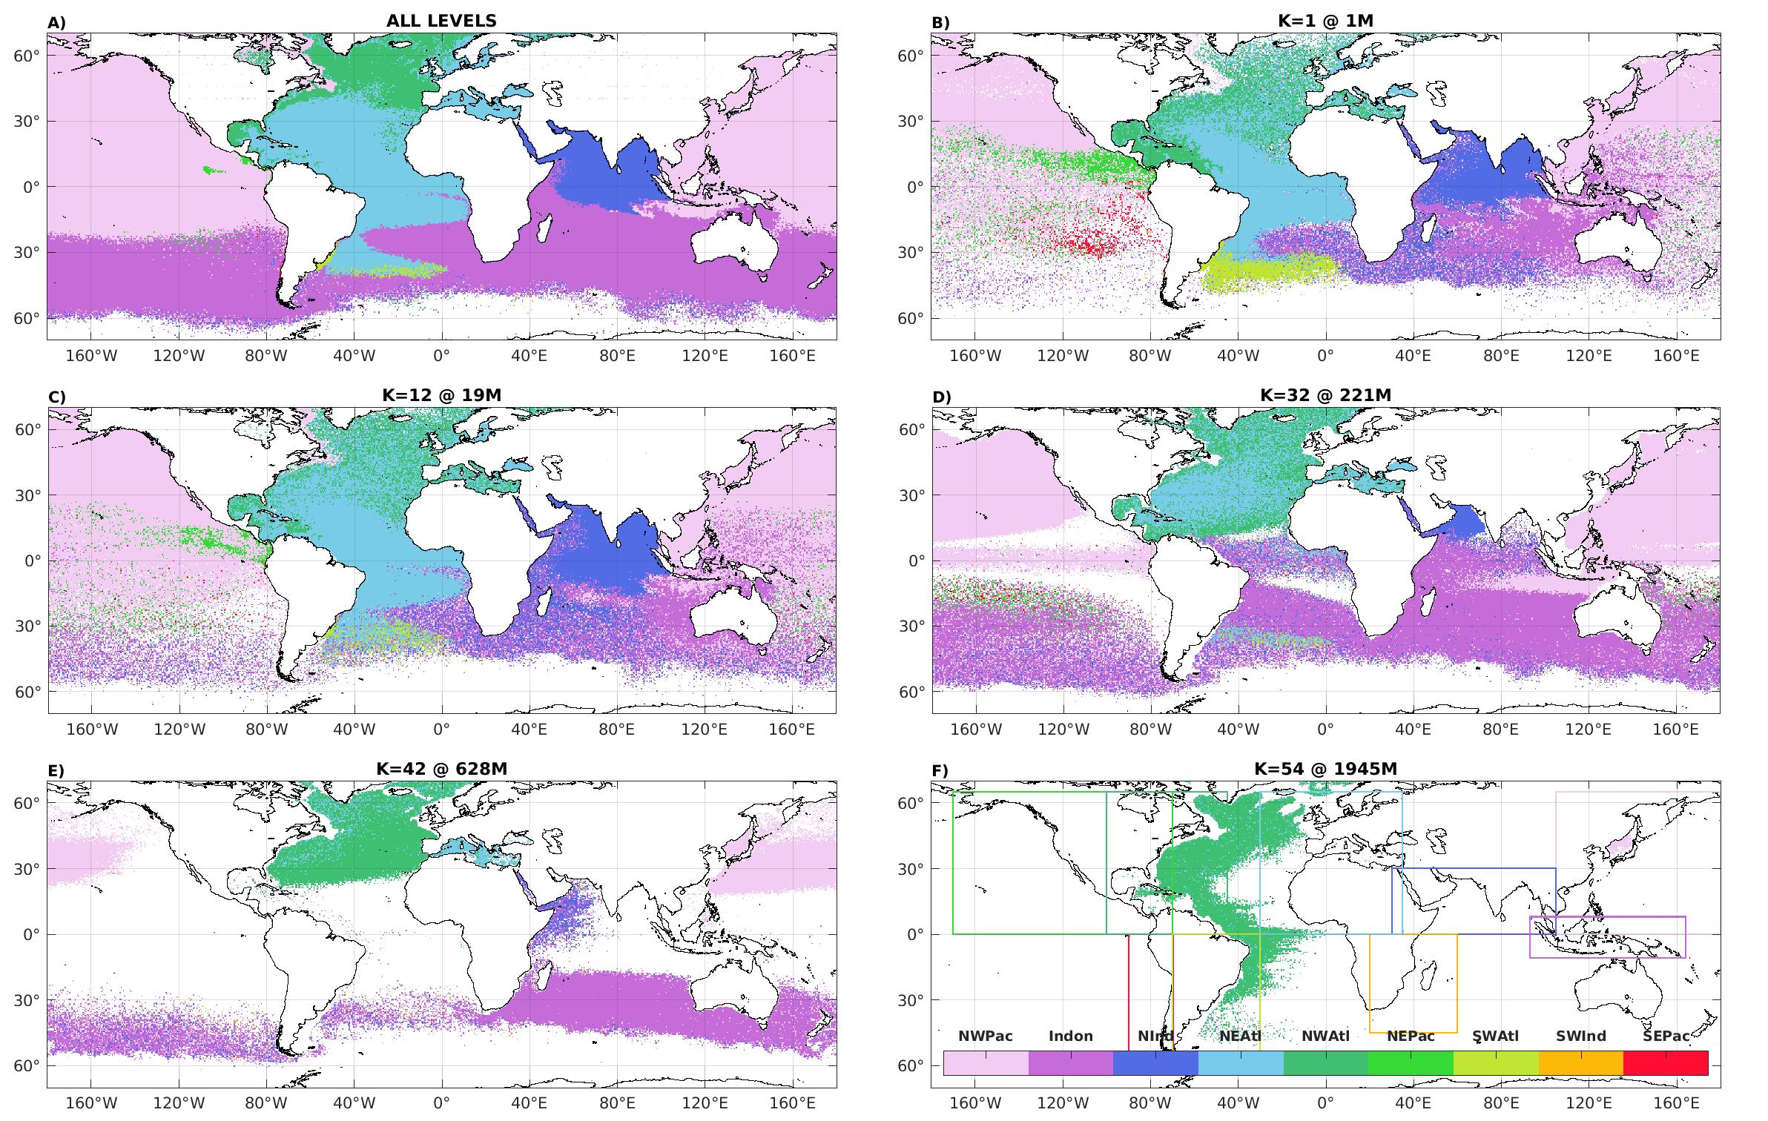
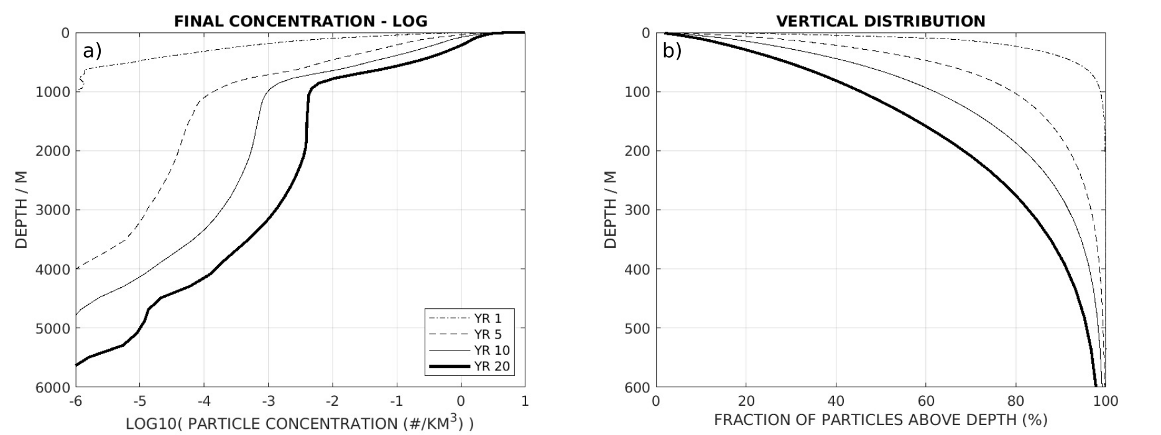
Three-dimensional dispersion of neutral "plastic" particles in a global ocean model
T. Huck, T., R. Bajon, N. Grima, E. Portela, J.-M. Molines, T. Penduff
Laboratoire d’Océanographie Physique et Spatiale, Brest ; IGE/MEOM, Grenoble
Abstract
The fate of plastics entering the 3D ocean circulation from rivers discharge is examined through the Lagrangian analysis of neutrally buoyant particles like plastic fibers. Particles are released continuously over 1991–2010 at the surface along the coasts according to monthly estimates of rivers plastic waste input. They are advected by daily currents from a state-of-the-art global ocean model at 1/12° resolution. At the end of the simulation (year 2010), particles remaining in the surface layer of 1 m thickness represent less than 2% of the total particles released. These are concentrated in the center of subtropical gyres, mostly in the South Indian Ocean, and the North Pacific, in relation with the large sources from Asia, and in good agreement with previous 2D numerical experiments in the surface layer. These patterns remain similar down to about 30 m depth, this upper layer strongly influenced by Ekman currents trapping about 20% of the total released particles. About 50% of the total released particles remain in the upper 100 m, and up to 90% are found in the upper 400 m at the end of the experiment. Below the mixed layer, they are more widely dispersed horizontally and follow the main global pathways of ocean ventilation of mode and deep water masses. Plastic particles, neutrally buoyant because of their small size or biofouling, are thus expected to be strongly dispersed in the global ocean thermocline following mode waters patterns, and reach the deeper layers following the North Atlantic Deep Water formation path. Two major source regions have a global impact. Particles from the western North Pacific spread over the whole Pacific Ocean poleward of 20°S, whereas particles from Indonesia spread over the whole latitude band from 60°S to 20°S.
Initial Horizontal and Vertical Spreading
Initial horizontal and dispersion
Final Distribution as a Function of Latitude and Depth
Concentration of particles (in #/km³) as a function of latitude and depth at the end of the 20-yr long simulation, zonally averaged over (A) the global domain, (B) the Atlantic, (C) Pacific, and (D) Indian sectors. The prominent tongue at 2000 m is clearly associated with the North Atlantic Deep Water.
Particles Age
Grille tripolaire ORCA utilisée pour les simulations réalistes réalisées avec la plateforme de modélisation NEMO. Les simulations sont réalisés sur les supercalculateurs nationaux, tels que ceux de l’IDRIS (photos du bas)
ORCA tripolar grid used to perform realistic simulations with the NEMO model platform. Simulations are run on IDRIS French national supercomputers (bottom picture)
(A) Total number of particles (NOP) released annually on the NEMO ORCA 1/12° grid according to Lebreton et al. (2017) river input. (B–F) Number of particles in the surface grid cells 1, 3, 6, 12, and 24 months after their release (log scale). The number in the figure title is the fraction of particles in the surface layer at the time after release: Only 22% remain at the surface after the first month .
Final Horizontal Distribution after 20 yr of 3D Advection
Mean age of the particles at different depth at the end of the 20-yr long simulation (in year): (A) For all particles summed over depth, (B) for particles at the surface, (C) at 20 m depth, (D) at 220 m depth, (E) at 630 m depth, and (F) at 2,000 m depth.
Particles Origin
(A) Horizontal distribution of particles summed over depth (# per 1/2°×1/2° grid cell). Number of particles per grid cell divided by the layer thickness (in #/m) (B) at the surface, (C) at 20 m depth, (D) at 220 m depth, (E) at 630 m depth, and (F) at 2,000 m depth (log scale). Level 32 at 221 m, with a 22.5 m thickness, contains the largest number of particles (3.7%) and shows the strongest dispersion.
Vertical Distribution
Region of origin of the particles at the end of the 20-yr long simulation: (A) For all particles over the water column, (B) for particles at the surface, (C) at 20 m depth, (D) at 220 m depth, (E) at 630 m depth, and (F) at 2,000 m depth. The color indicates the region from which the largest number of particles originates, with the regions defined according to the geographical boundaries drawn in (F). The regions are ordered according to the total amount of particles released, the western North Pacific (53.5%), Indonesia (17.2%), the North Indian Basin (13.8%), the eastern North Atlantic including the Mediterranean Sea and the Gulf of Guinea (7.6%), the western North Atlantic (4.6%), the eastern North Pacific (0.6%), the western South Atlantic (0.4%), the western South Indian (0.1%), the eastern South Pacific, and eastern South Atlantic (0.04%).
For more informations: Thierry.Huck@univ-brest.fr
Huck, T., R. Bajon, N. Grima, E. Portela, J.-M. Molines, T. Penduff, 2022: Three-dimensional dispersion of neutral "plastic" particles in a global ocean model. Frontiers in Analytical Science, 2, 868515, doi: 10.3389/frans.2022.868515.

